Slide 1
Credit EDA Assignment
Deepak ROut

Slide 2
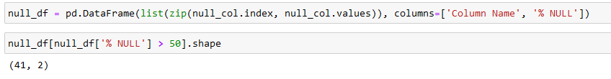
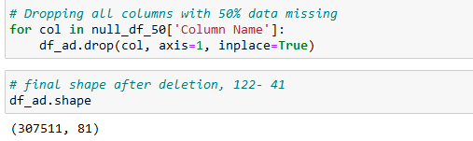
Data Cleaning
Prepared a data frame of missing value
Above snippet shows 41 column with more than 50% data missing. Which is huge. We can’t draw insightful idea from these column.

Slide 3
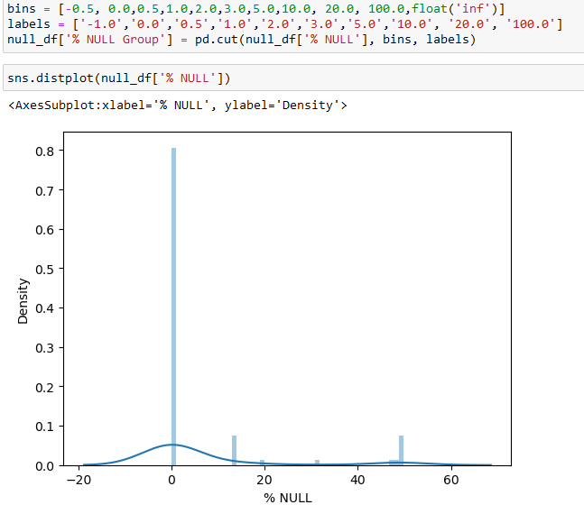
Visualizing % data missing
There are 80% data has less than .5 missing value and few above 13-14%

Slide 4
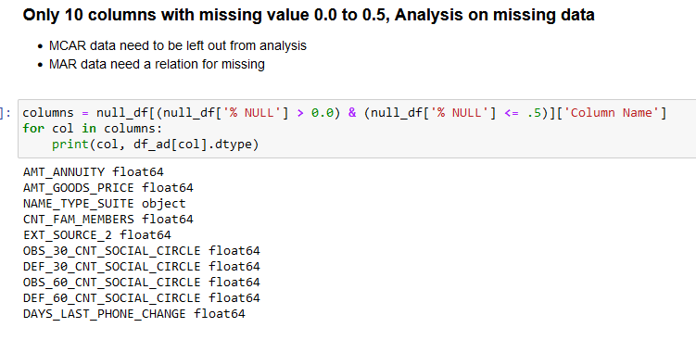
Analysing missing Value below 13%

Slide 5
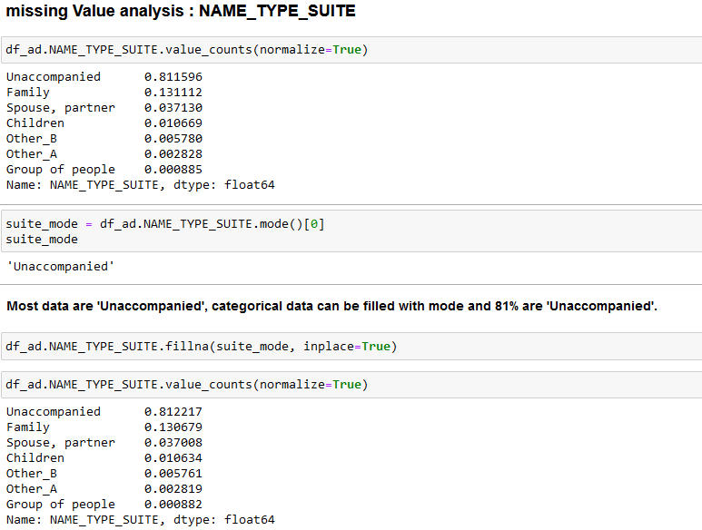

Slide 6
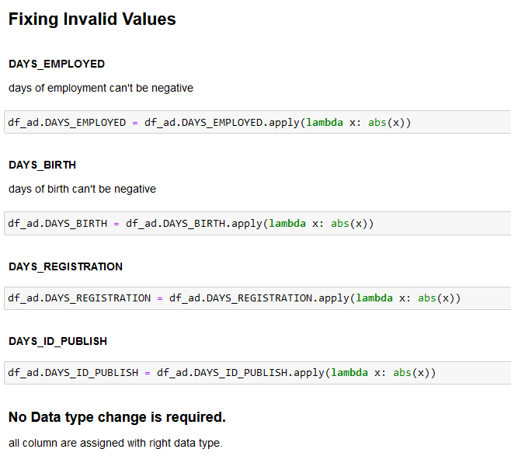
Fixing invalid Value

Slide 7
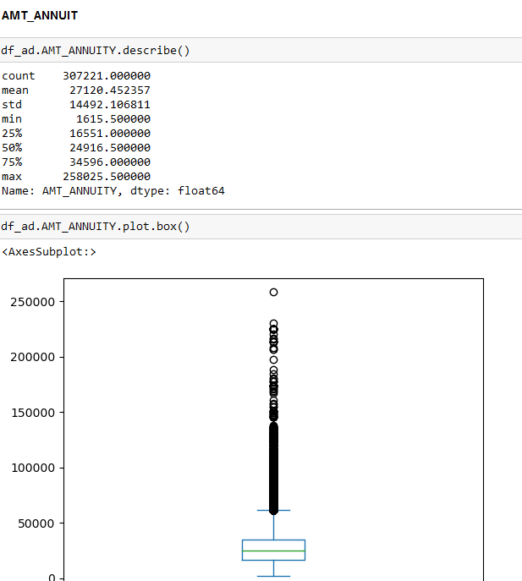
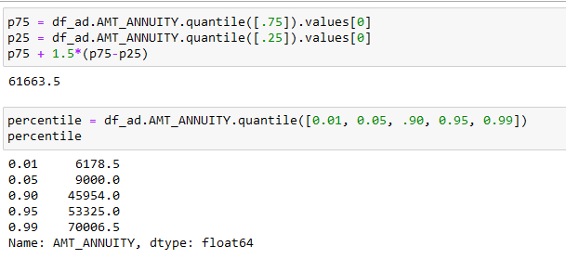
Outlier
We could see from the boxplot there are outlier.
Look at some percentile. It is evident.

Slide 8
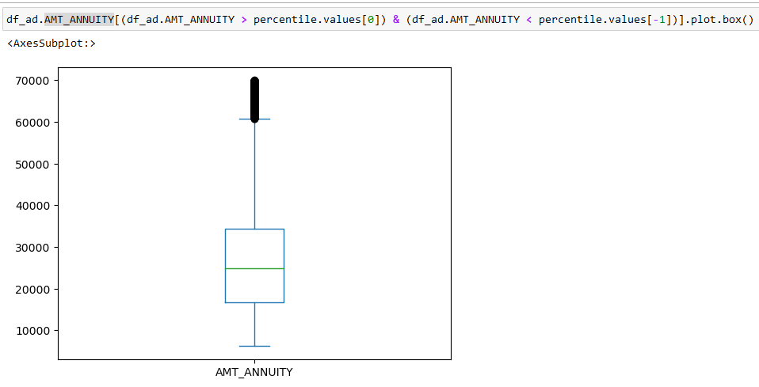
If we treat AMT_ANNUITY

Slide 9
Other Outlier
AMT_INCOME_TOTAL
AMT_CREDIT
DAYS_EMPLOYED
These data exceeds 1000yrs. Which can be treated as missing value. Days employed used to create years_employed.
Most people are employed less than 10yrs
AGE
These data exceeds 1000yrs. Which can be treated as missing value. Days employed used to create years_employed
Most people are between 30-50.

Slide 10
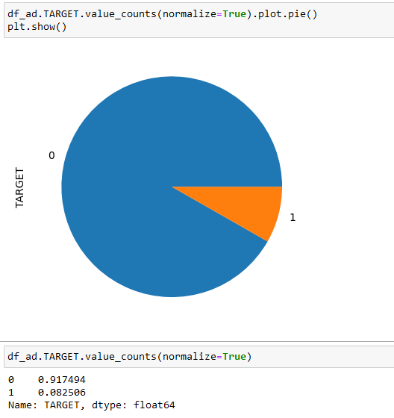
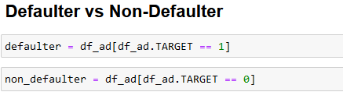
Target Imbalance
Creating two separate dataset for analysis

Slide 11
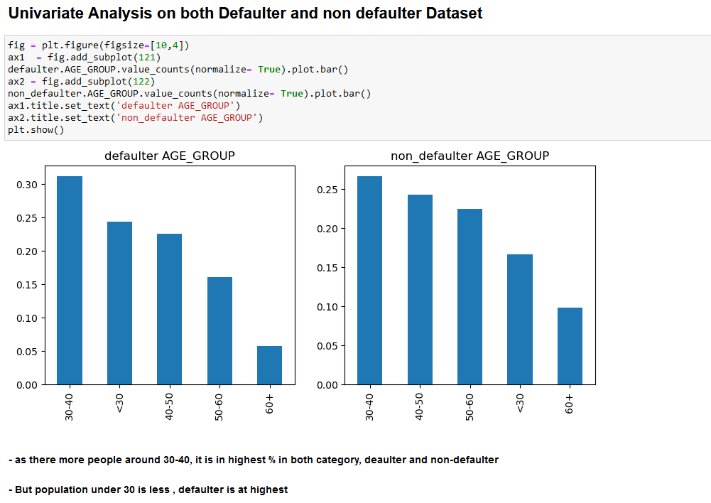
Univariate analysis

Slide 12
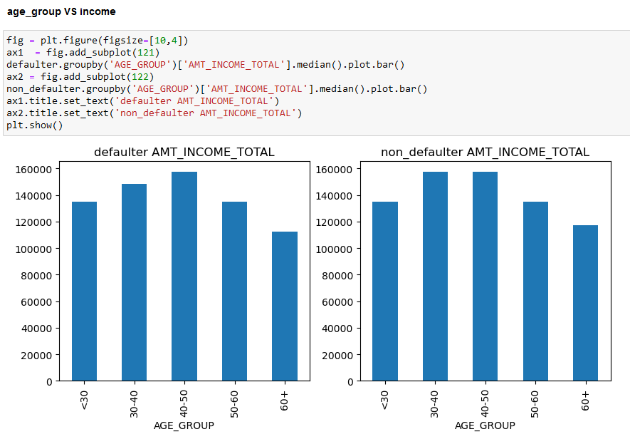
Age Group vs Income
Few age group was
more defaulter,
income ain’t the
Reason. 30-50 earns
Good.

Slide 13
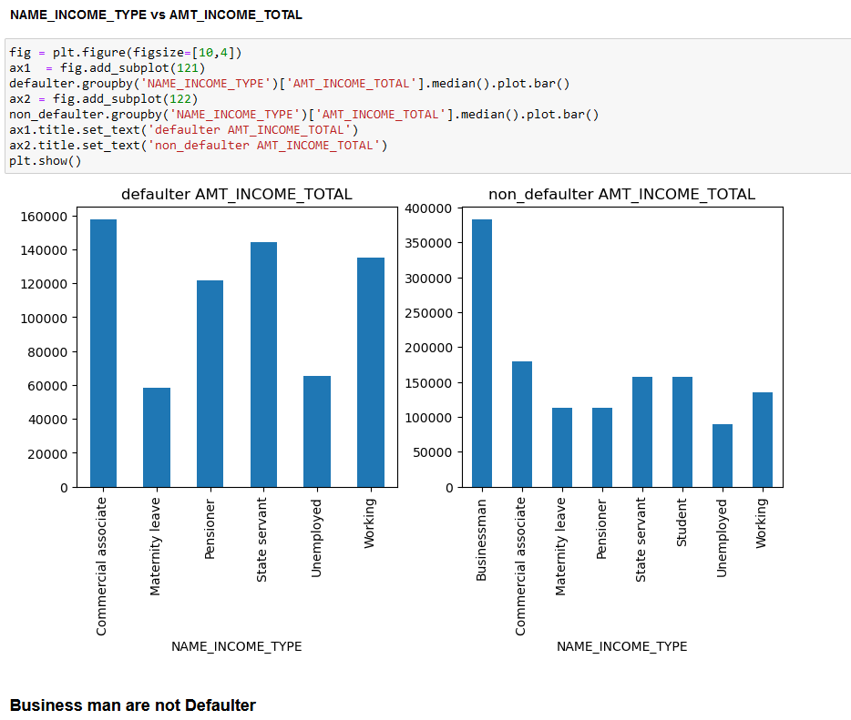

Slide 14
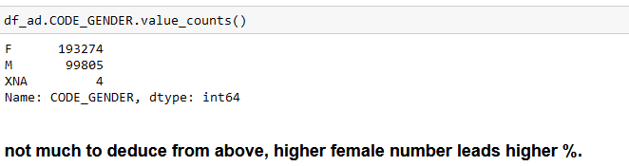
High Earners
We can’t say high earners are defaulter.
Commercial Associate are the defaulter.
Female Vs Male

Slide 15
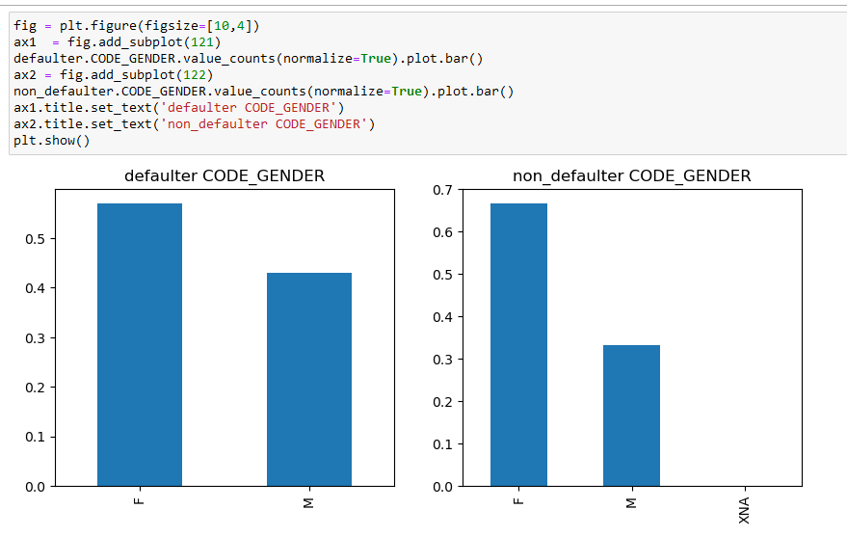
Female Vs Male
Female to male ratio is high. So both defaulter and non defaulter ratio is high.

Slide 16
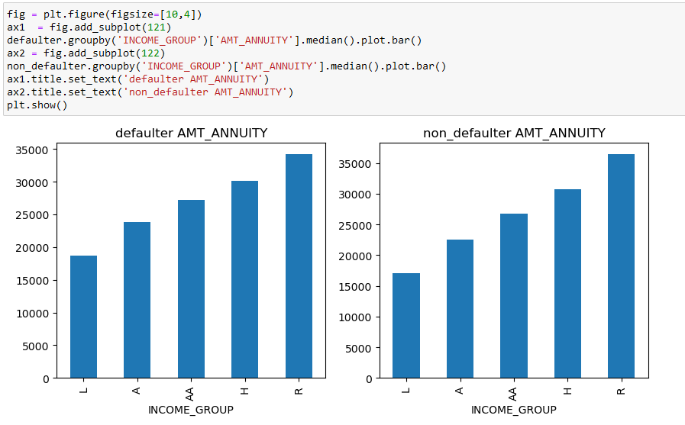
INCOME_GROUP TYPE vs AMT_ANNUITY
Higher the income higher annuity is being issued

Slide 17
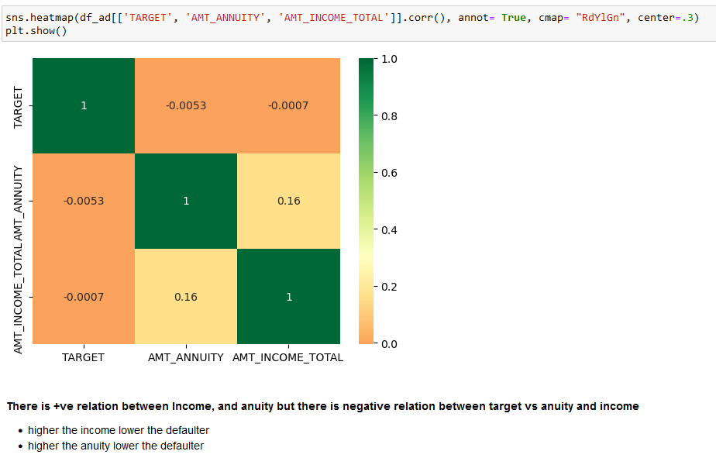
TARGET, AMT_ANNUITY, AMT_INCOME_TOTAL

Slide 18
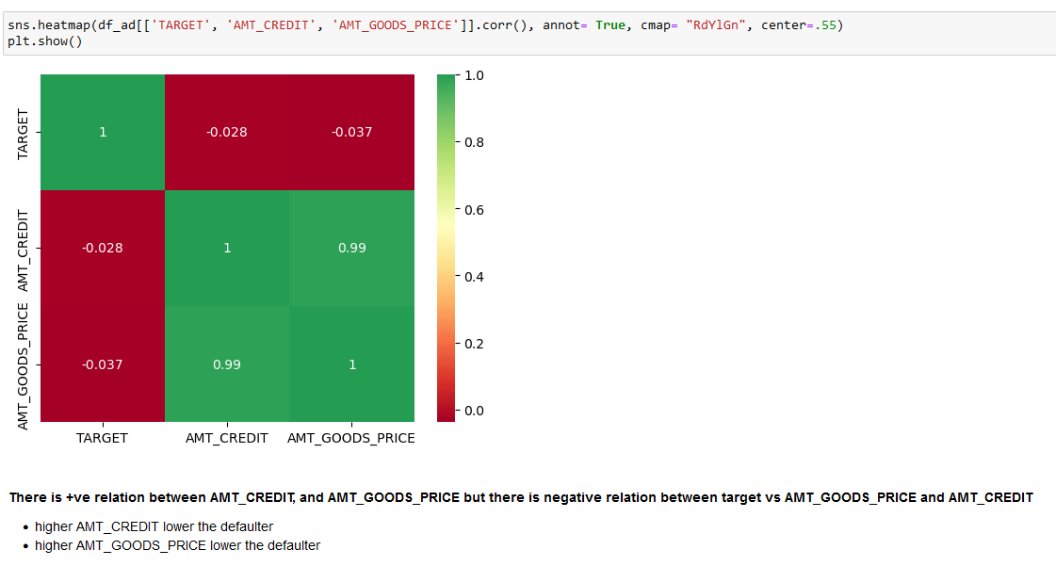
'TARGET, AMT_CREDIT, AMT_GOODS_PRICE
Good price might be depicting quality product

Slide 19
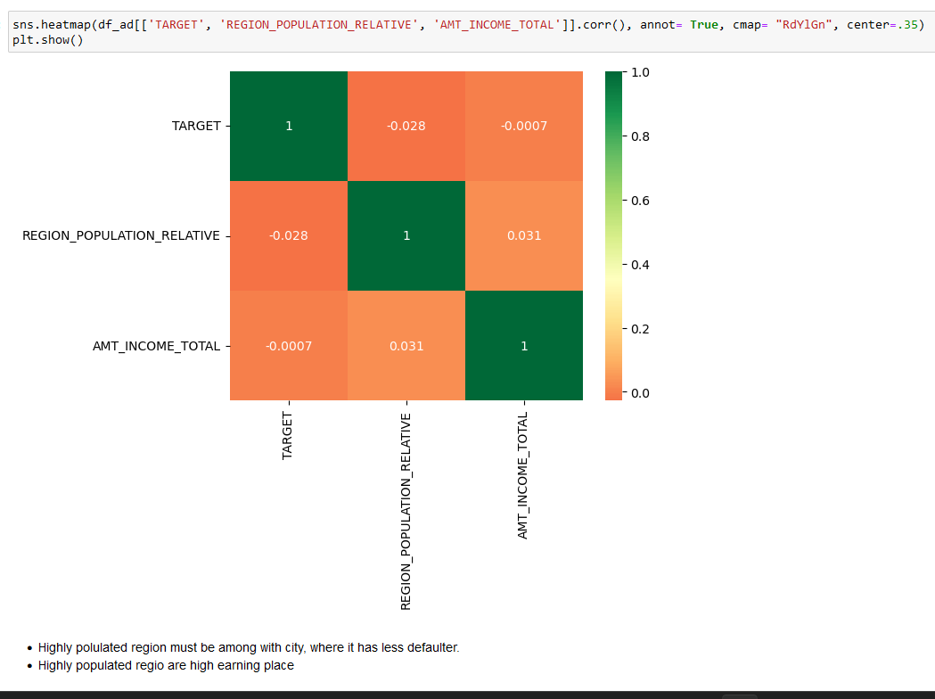

Slide 20
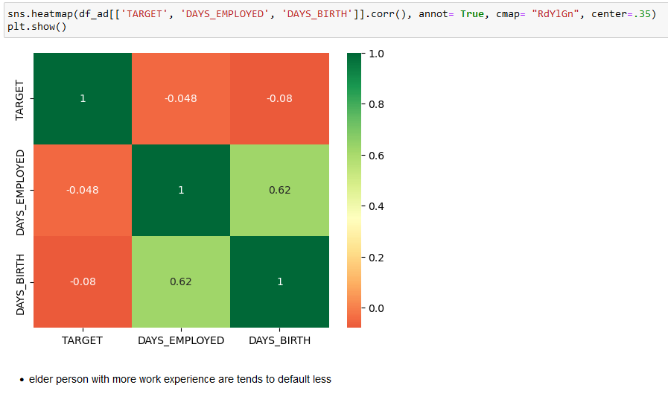
TARGET, DAYS_EMPLOYED, DAYS_BIRTH

Slide 21
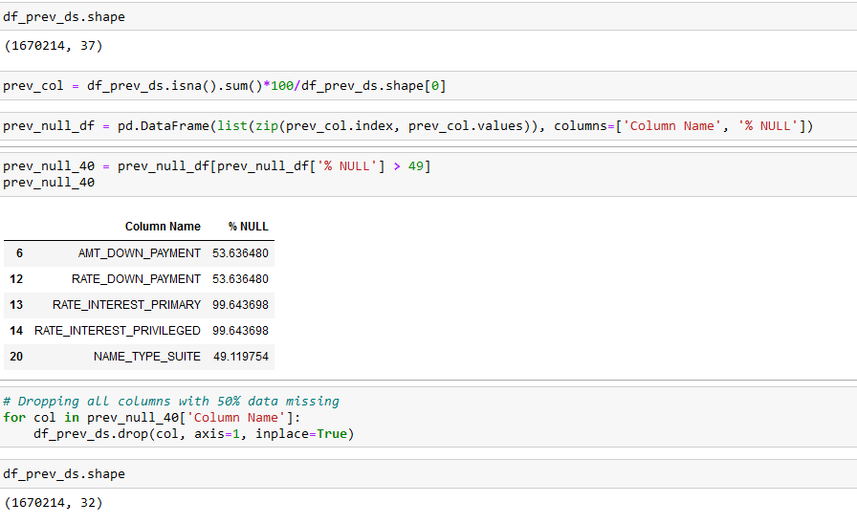
Previous Application Data Set

Slide 22
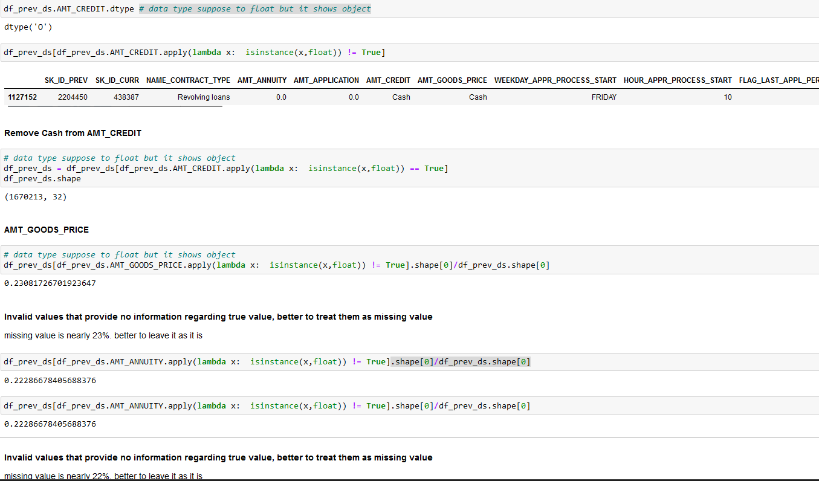
Treating Missing Type

Slide 23
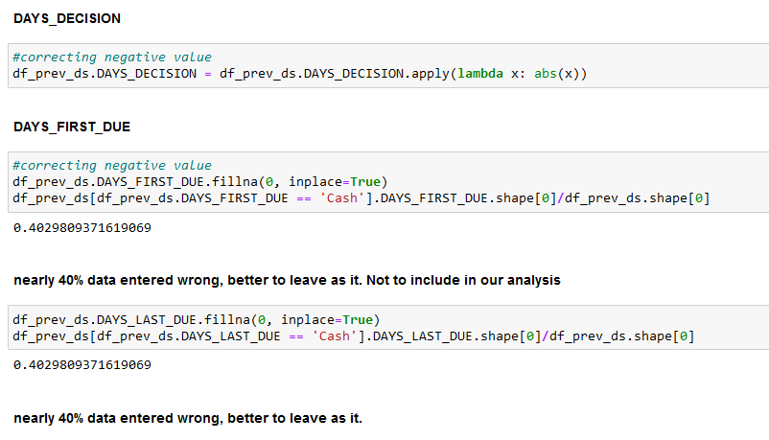
Invalid Data
Missing value marked as Cash.

Slide 24
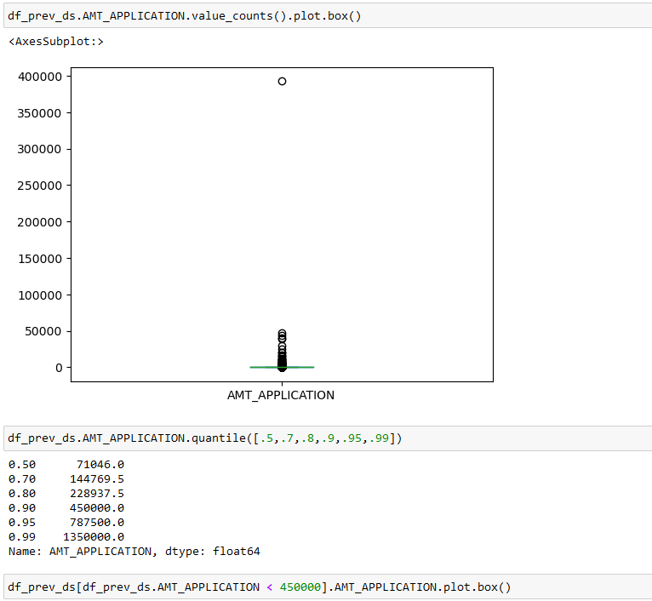
Outlier

Slide 25
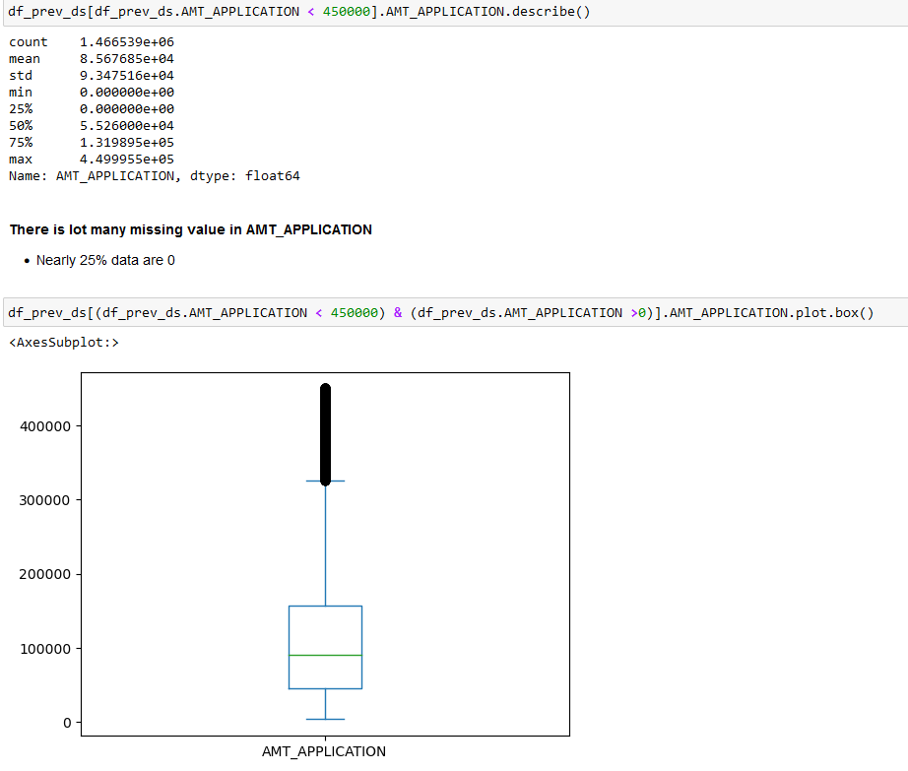
AMT_APPLICATION continue
We spot two issues with AMT_APPLICATION
25% data are missing
We need to cap the higher amount too

Slide 26
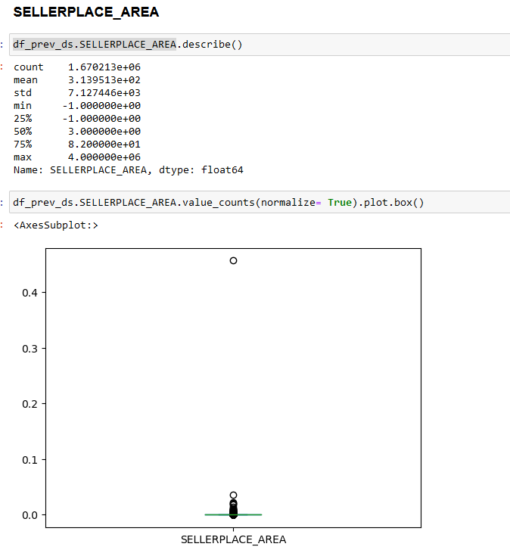
SELLERPLACE_AREA
We can spot similar issue with SELLERPLACE_AREA
There is missing value marked as -1.

Slide 27
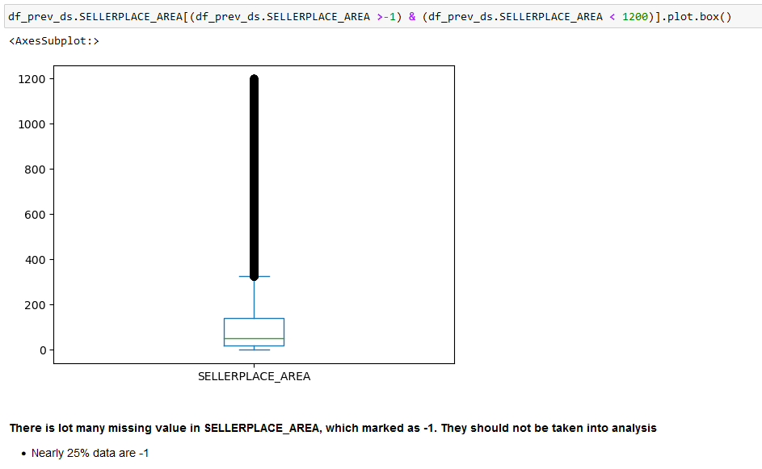
SELLERPLACE_AREA
We need to treat both upper fence
outlier and missing value

Slide 28
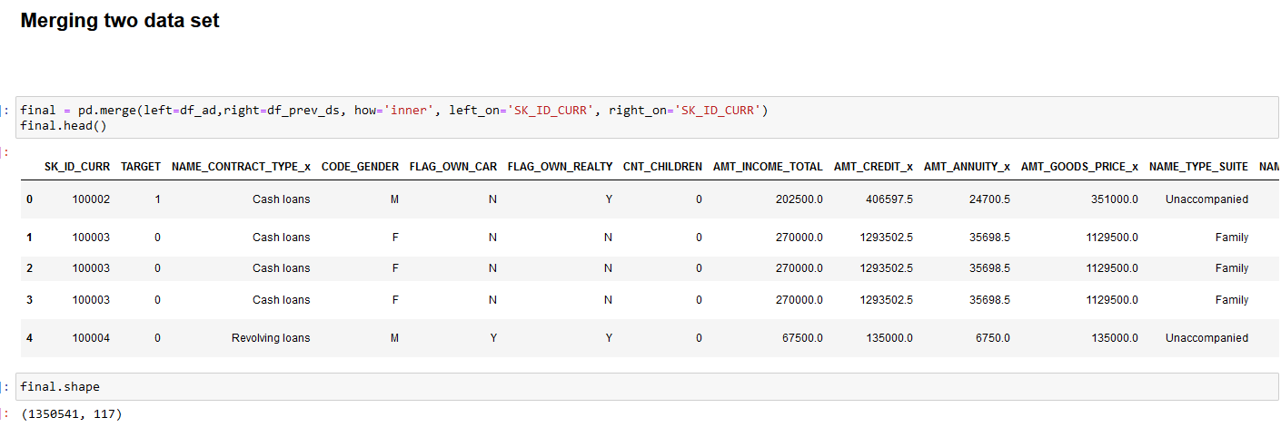
Merge Data

Slide 29
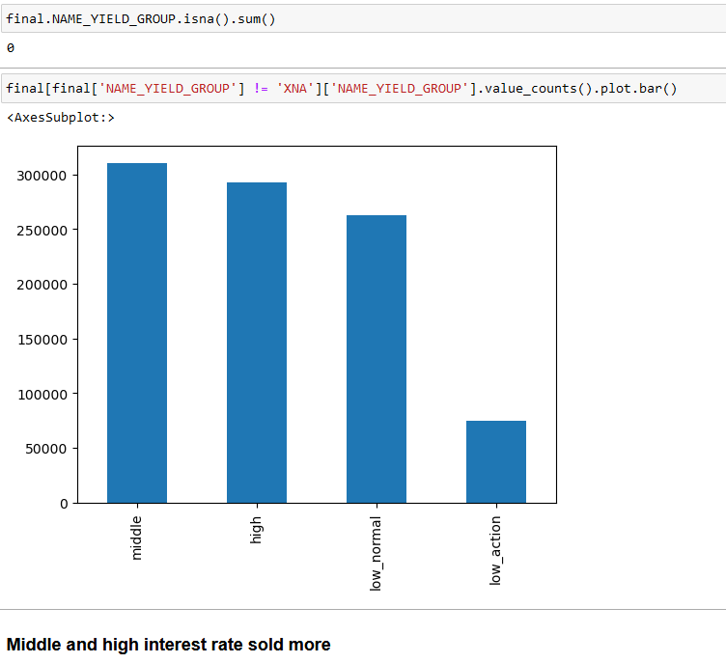
NAME_YIELD_GROUP

Slide 30
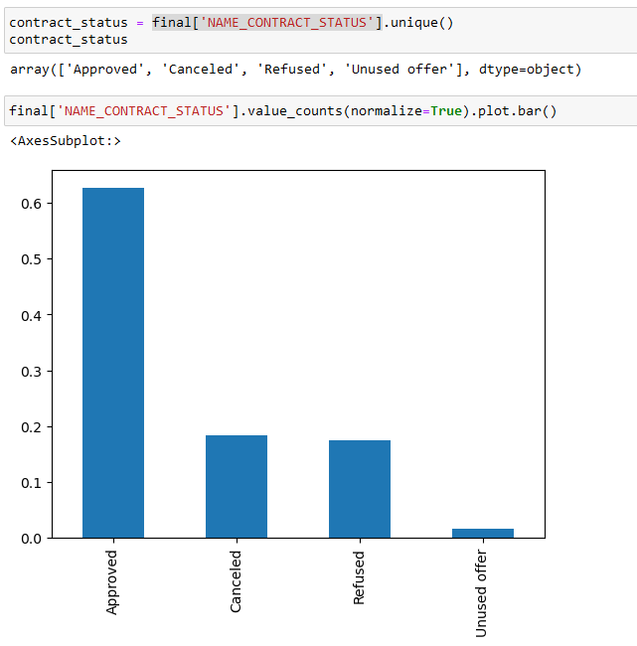
NAME_CONTRACT_STATUS Vs TARGET
Major Contract status is Approved

Slide 31
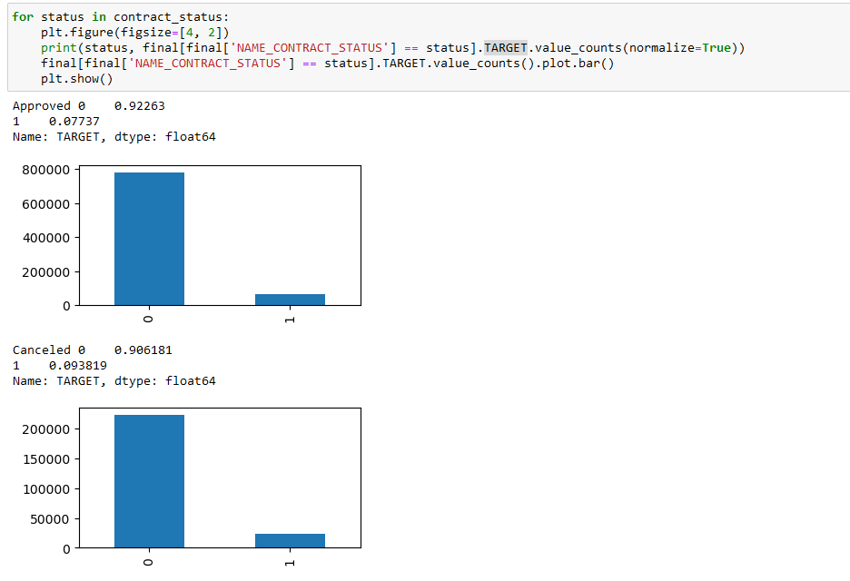
Continue

Slide 32
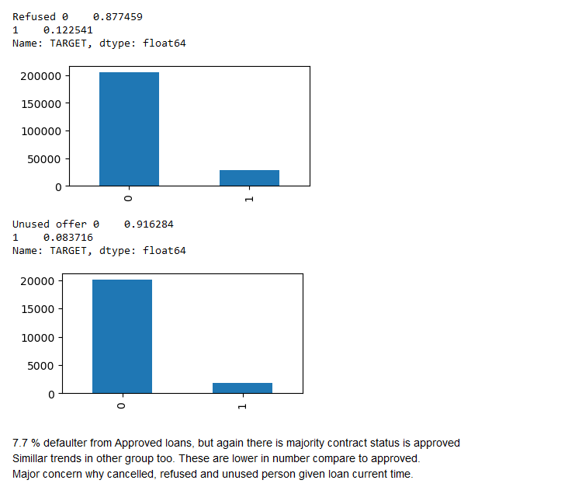
Continue

Slide 33
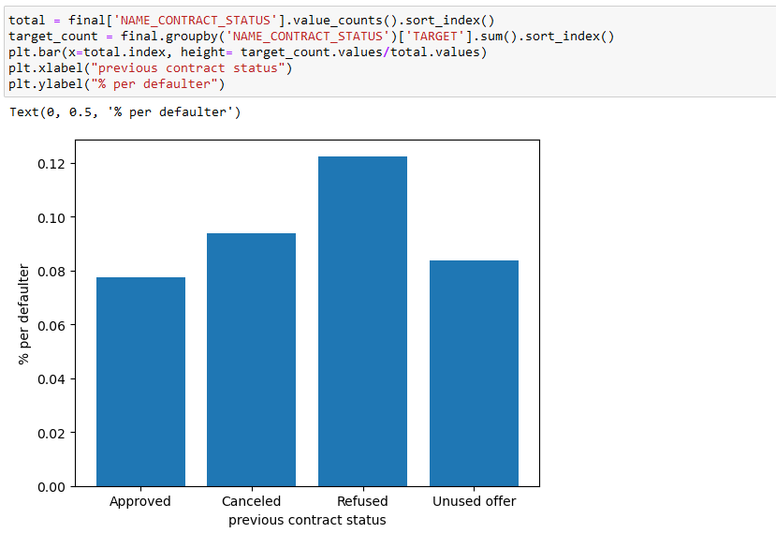
Continue with Bivariate
If we look at normalize data, it shows Refused for loan in previous application are most defaulter. A strong scrutiny required on approving loan.

Slide 34
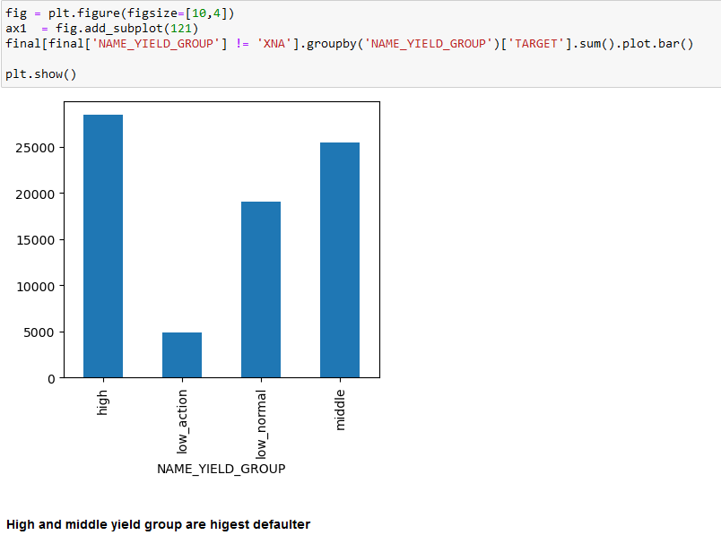
Bivariate

Slide 35
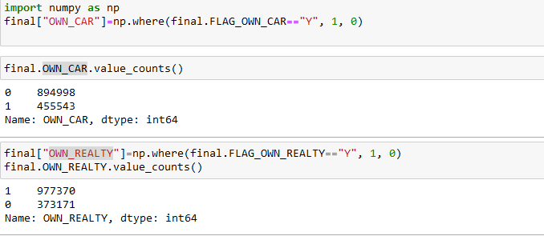
Correlation of OWN_CAR, OWN_REALTY

Slide 36
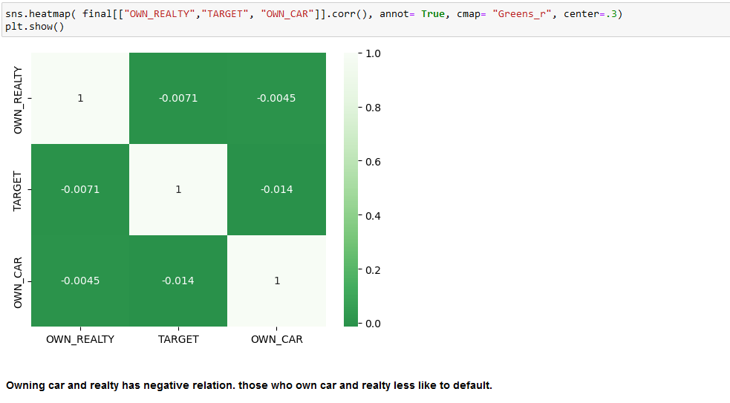
Owning Car and Realty shows financial security.

Slide 37
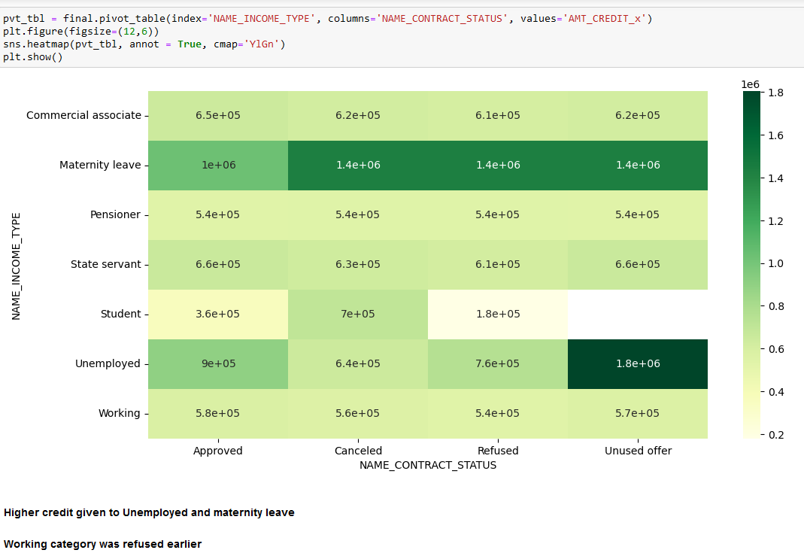
NAME_INCOME_TYPE VS NAME_CONTRACT_STATUS VS AMT_CREDIT

Slide 38
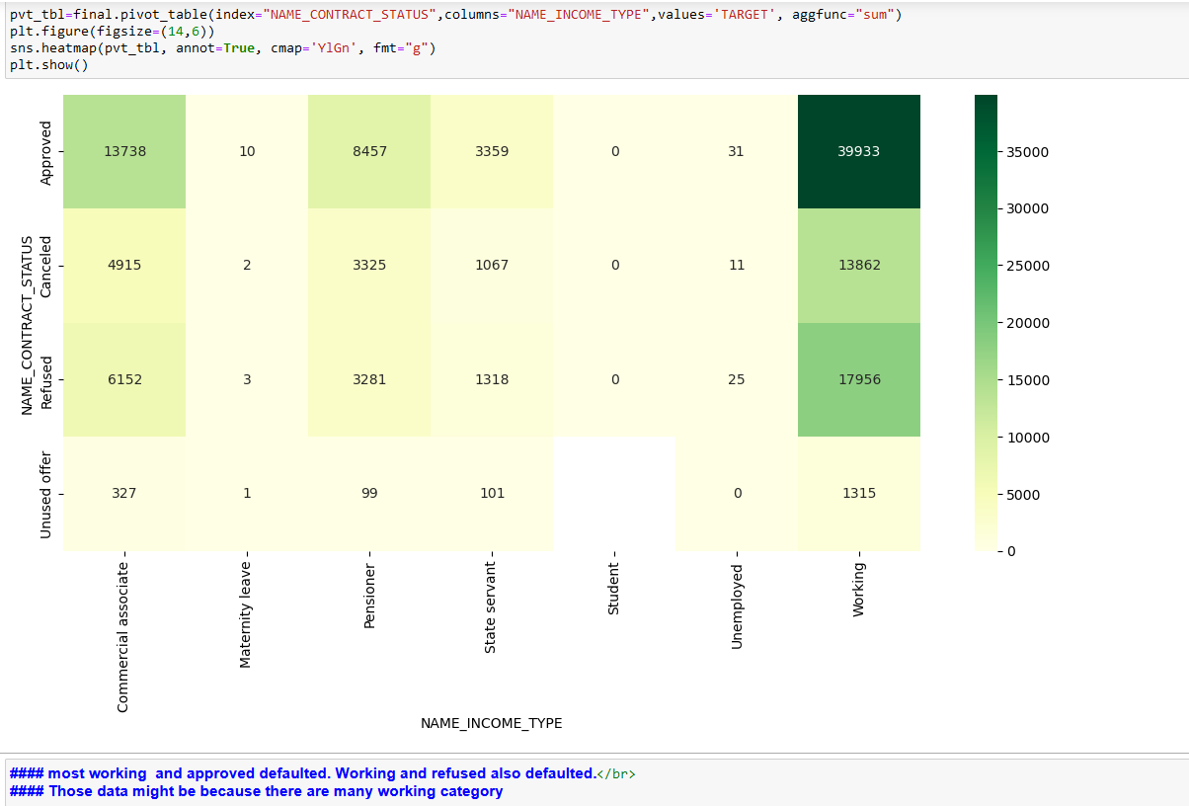
NAME_CONTRACT_STATUS VS NAME_INCOME_TYPE VS TARGET

Slide 39
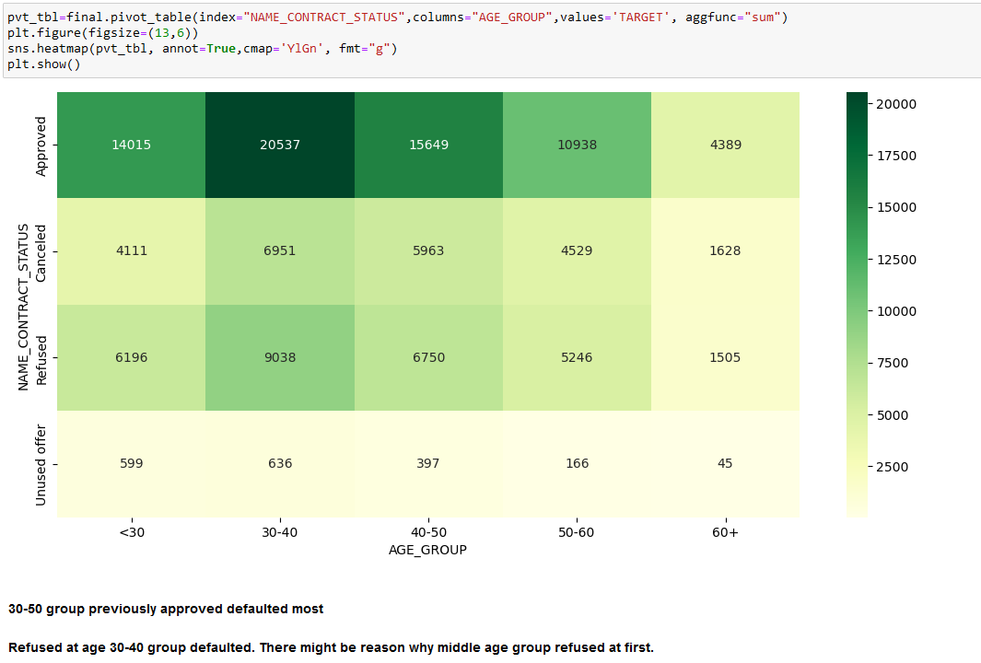
NAME_CONTRACT_STATUS VS AGE_GROUP VS TARGET

Slide 40
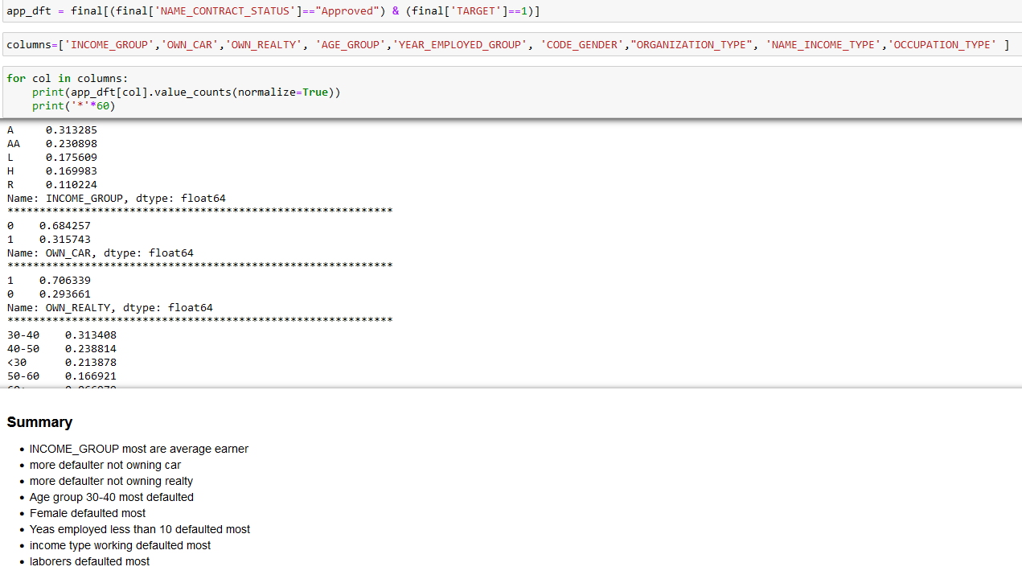
Further analysis on defaulted got approved
Female applied mostly for loan, female get special interest rate. Female defaulting can’t be taken into account

Slide 41
Final Summary
more defaulter not owning car
more defaulter not owning realty
elder person with more work experience are tends to default less
higher AMT_CREDIT lower the defaulter
higher AMT_GOODS_PRICE lower the defaulter.
higher the income lower the defaulter
higher the annuity lower the defaulter
Female defaulted most, but they applied the most.
Years employed less than 10 defaulted most
income type working defaulted most.
laborers defaulted most.
30-50 group previously approved defaulted most

Slide 42
Continue…
Card portfolio has most defaulter
High and middle yield interest rate group has highest defaulter. That might because it sold more.
Those who refused earlier has defaulted current time.
Higher credit given to Unemployed and maternity leave
Highly populated region must be among with city, where it has less defaulter. Highly populated region might be high earning place
Refused at age 30-40 group are defaulted. There might be reason why middle age group refused at first.

